Slide 1
Musical Transcription of Drum Patterns Using Main Audio Features in KNN
by Charles Jayson L. Dadios BS Computer Science

Slide 2
Abstract
Drums is a promient instrument in our musical culture. The most accurate way to learn how to play the drum parts of a song is by reading a drum musical chart. Learning and familiarizing to read drum notation can be an easy skill to pickup, but learning how to write charts takes more time and effort. This challenge encourages drummers to learn songs by ear, but people tend to forget the correct parts and play inconsistenly.
Automatic Drum Transcription (ADT) can encourage drummers to read charts, and reading unlocks learning. An algorighm was developed to transcribe drum recordings into two formats: MIDI and PDF. KNN was used to classify what particular instrument of the drums sounded off. The classifier used the drum's main audio features as a 77-dimensional feature vector. The algorithm yielded promising results to offer solution to the ADT problem.

Slide 3
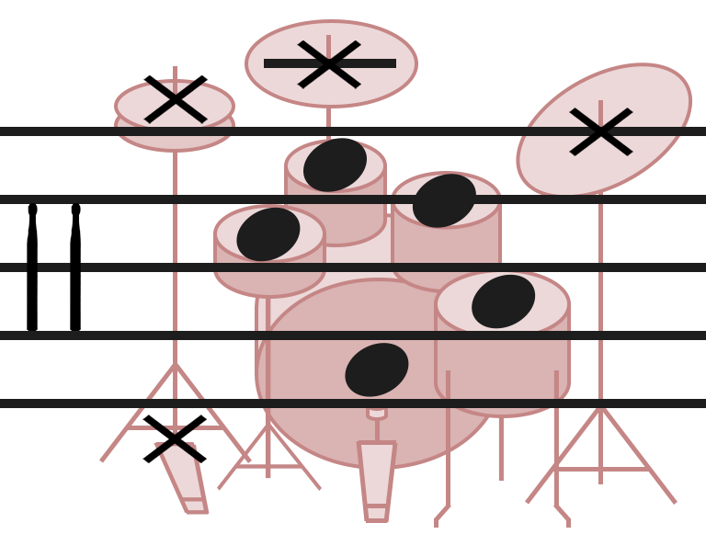
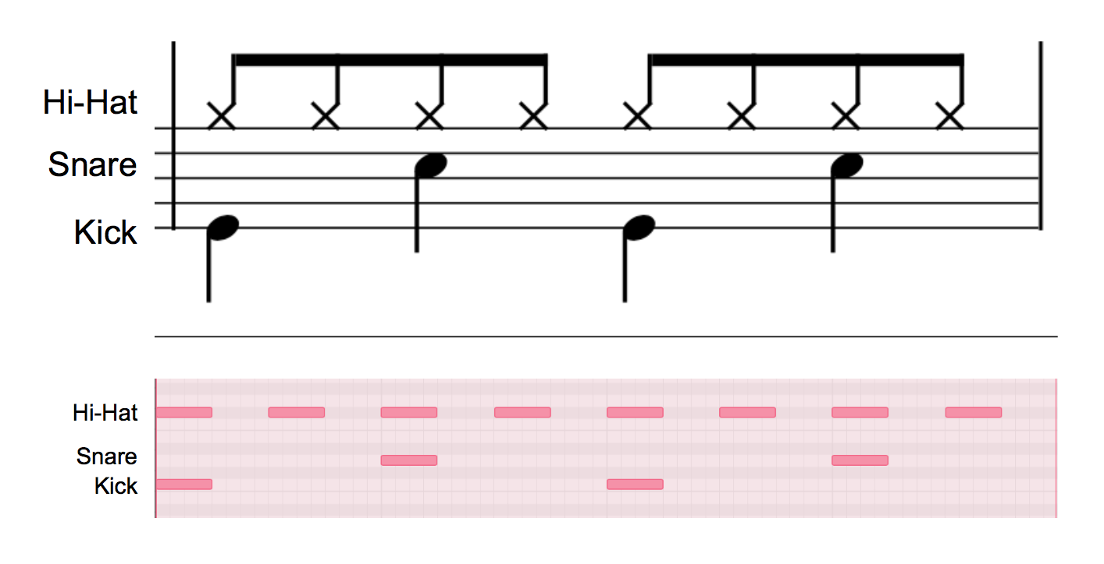
Billy Jean
1 & 2 & 3 & 4 &

Slide 4
Introduction
Automatic Drum Transcription (ADT) in simple terms is the process of converting a drum performance into a record usually as a drum notation printed as a music sheet.
KNN is a classification algorithm which uses data points to find the k-number of closest classes as the basis of prediction.
Feature vector used

Slide 5
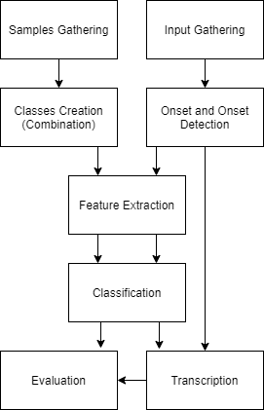
Methodology

Slide 6
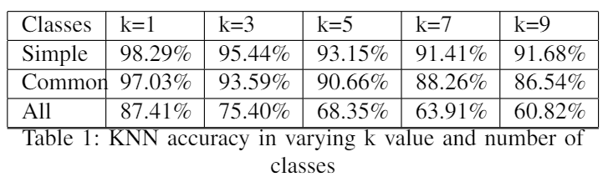
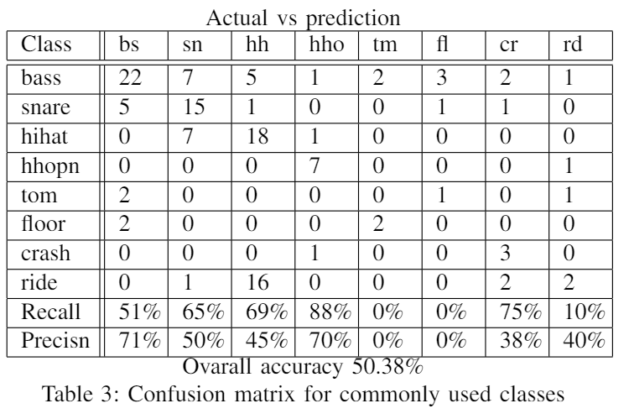
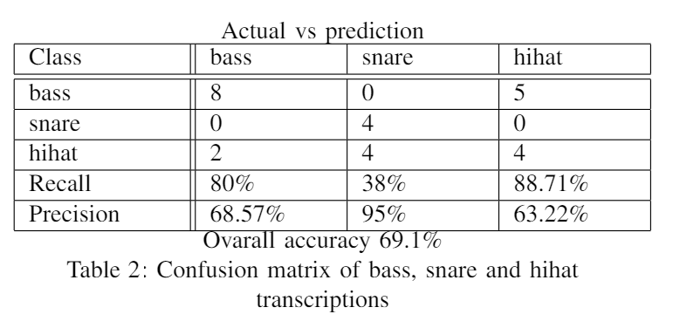
Results

Slide 7
Conclusion
Using main audio features in KNN is effective in Automatic Drum Transcription (ADT), with the highest overall accuracy achieved when k=1, even with the feature vector dimension of 77, in this case.
Recommendation: Just like speech recognition, ADT may improve with the help of other machine learning techniques like Hidden Markov Model, or Neural Networks.

Slide 8
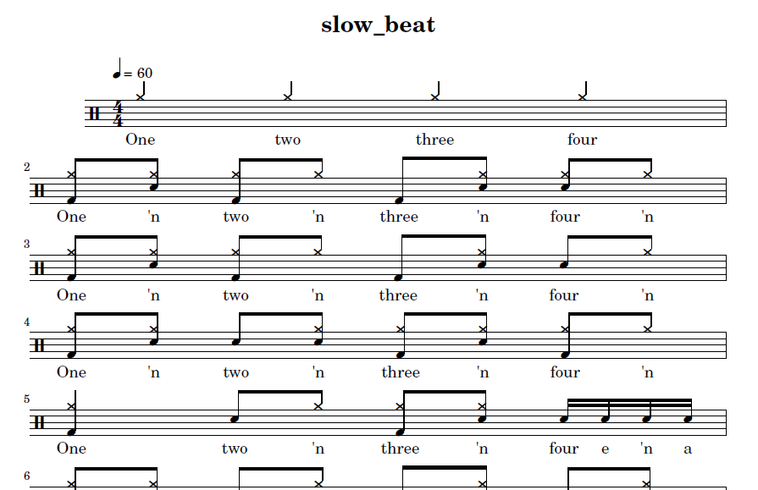


Demo
Input mp3 Output midi exported as wav

Slide 9
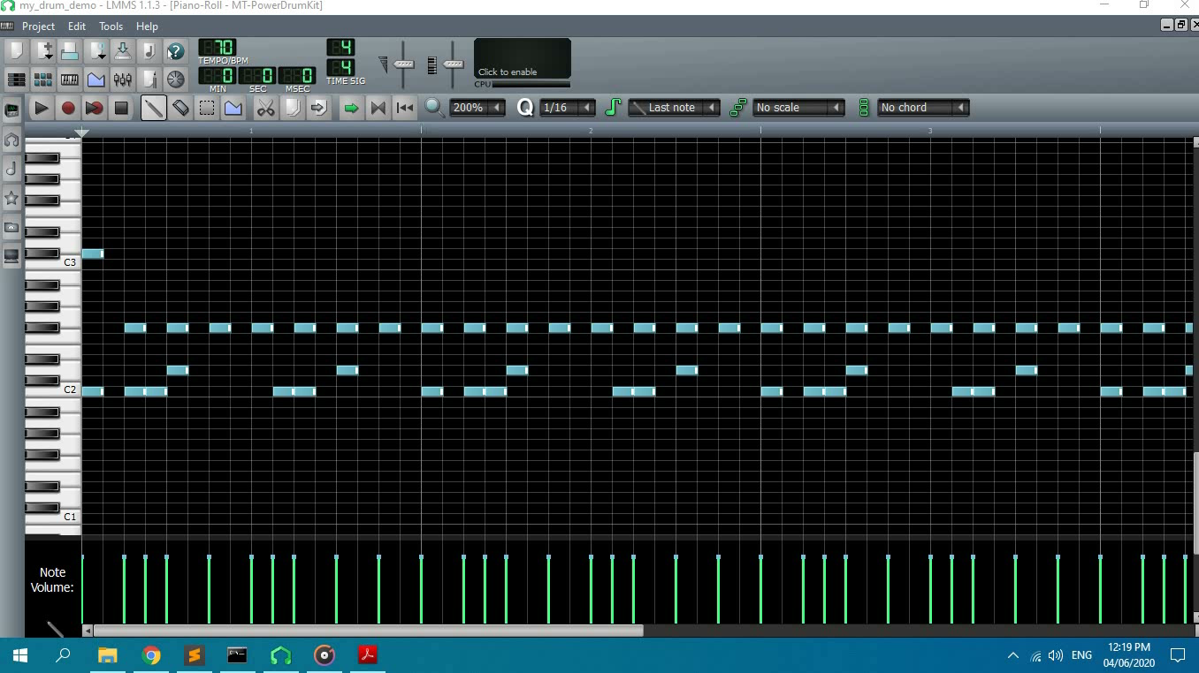
Demo Input

Slide 10
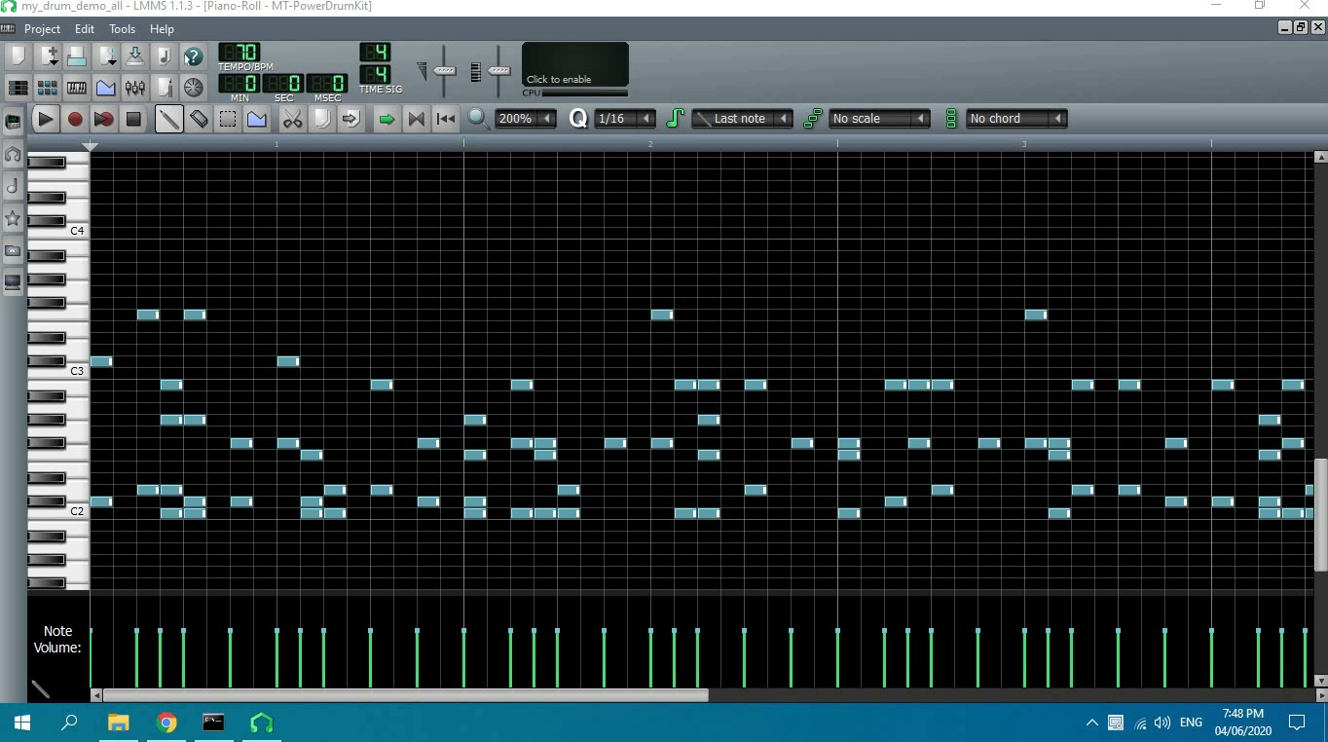
Demo Output

